Slide 1
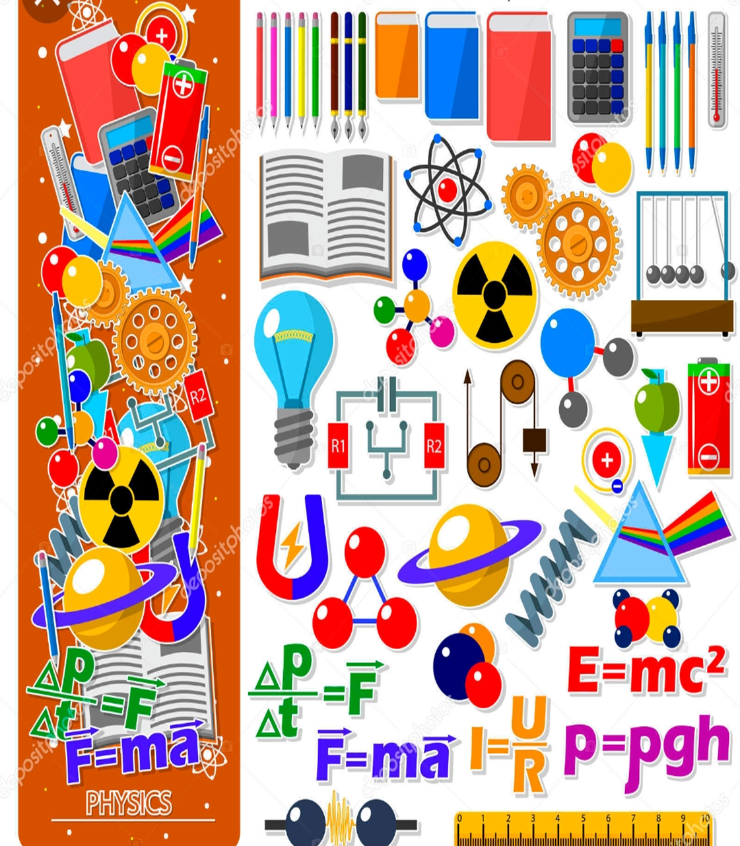
«Do you know?»
«Сен білесің бе?»
Физика пәні бойынша сыныптан тыс іс-шара
7,8 сыныптарға арналған
Пән мұғалімі: Жунусова Дина Шакаримовна
Іс- шараның мақсаты:
«Оқушылардың физикалық терминдерді ағылшын тілінде меңгеру деңгейін анықтау»
The purpose of the event:
« Determine the level of knowledge of physical terms in the English language »

Slide 2
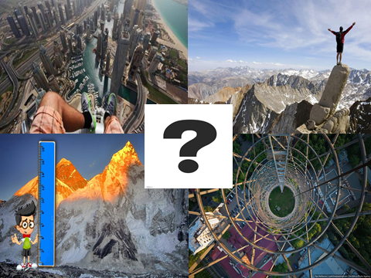
The name of your group
We will give you 4 pictures and you need to find the general word. This word will be the name of your group
3 minutes

Slide 3
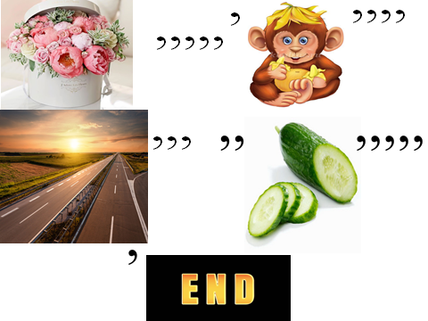
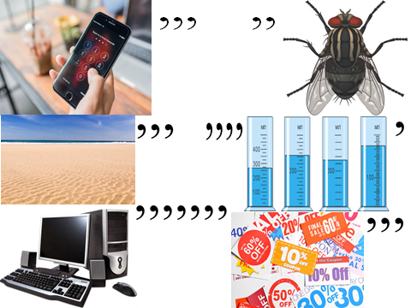
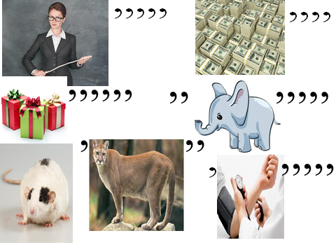
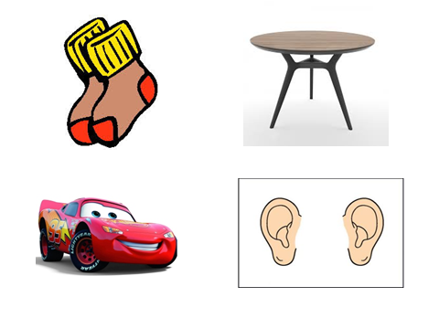
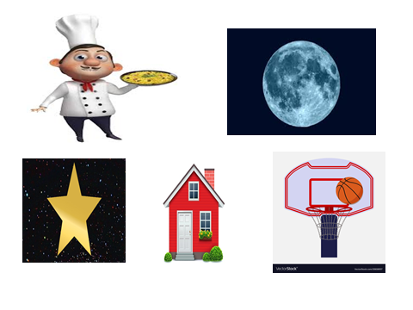
Who is more intelligent?
We will give you rebuses and your goal is to find out the word in
3 minutes

Slide 4
Black box
We have the black box and there are physical objects , you can’t see which are inside, so you need to guess what is the object is.

Slide 5
Funny physics

Slide 6
True or false
It will be competition between captains of groups and if you answer correctly for the question, you will move forward for one step, who will go till the finish first, that one will be the winner.

Slide 7
Matching
There will be the words inside the envelope in 2 languages so you have to match the same words.

