Slide 1
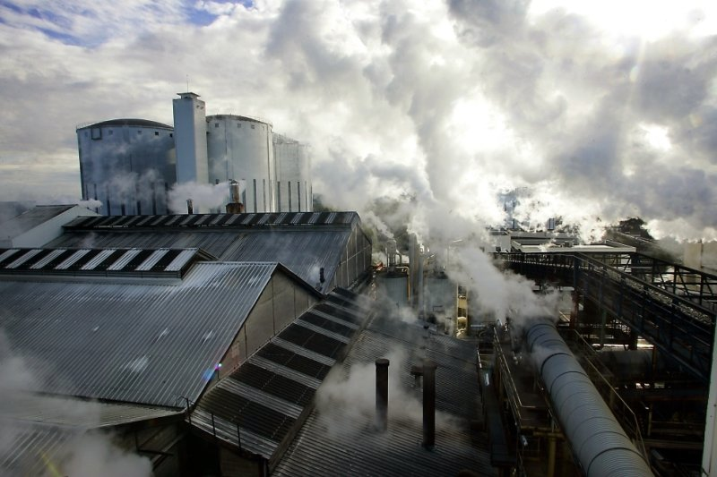
ECOLOGICAL PROBLEMS

Slide 2
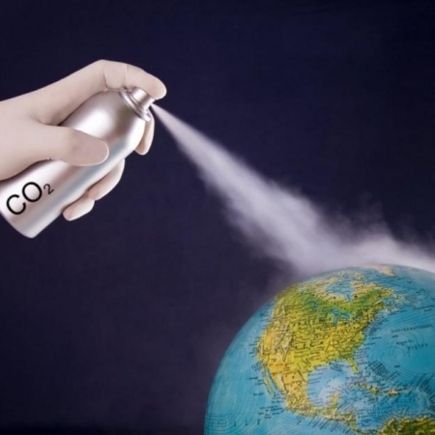
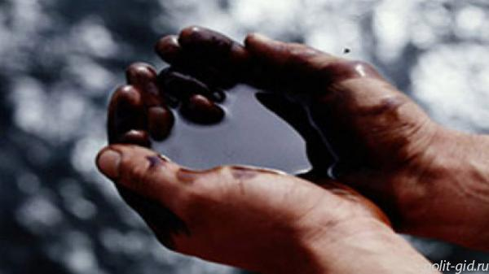
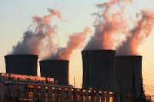
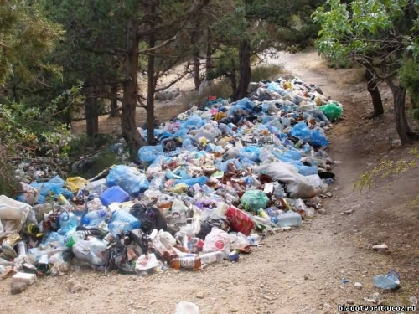
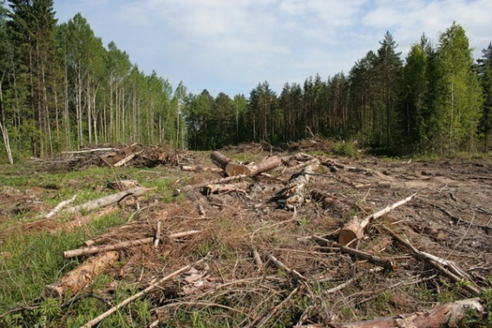
What ecological problems?
The change of the environment as a result of impacts or natural disasters.

Slide 3
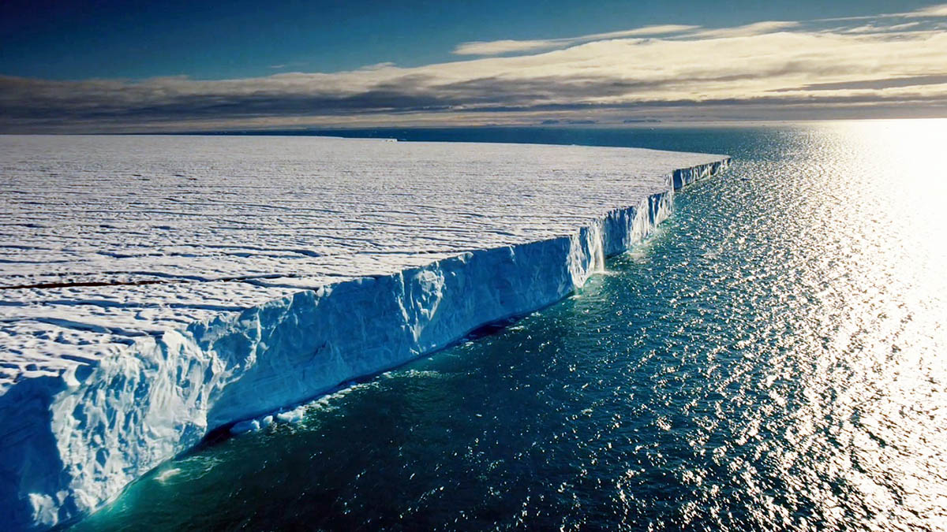
Types of problems
Local
Global
Regional
These problems need to be addressed and development funds

Slide 4
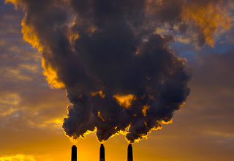
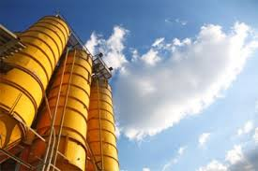
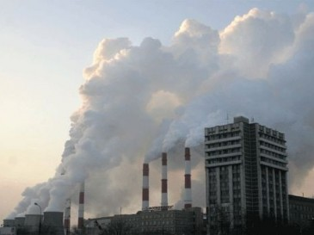
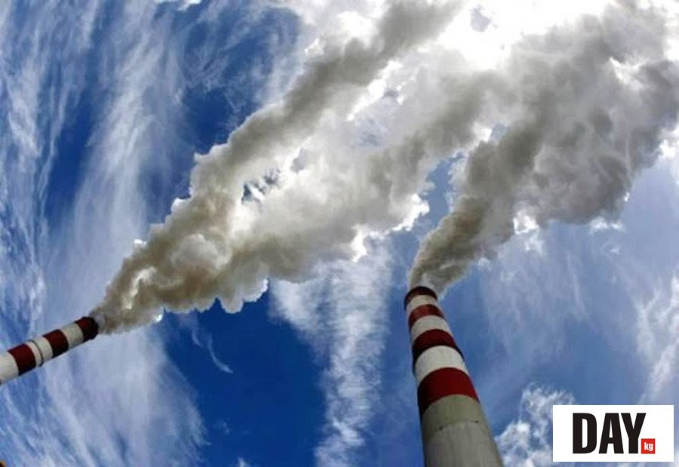
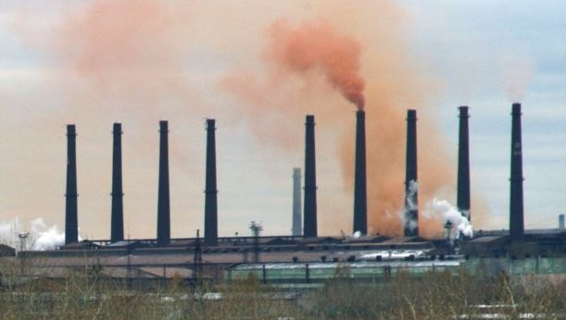
Local problem
The plant is discharged untreated into the river their waste harmful to health. This - a violation of the law. Environmental authorities have fined a plant. Special science without the need.

Slide 5
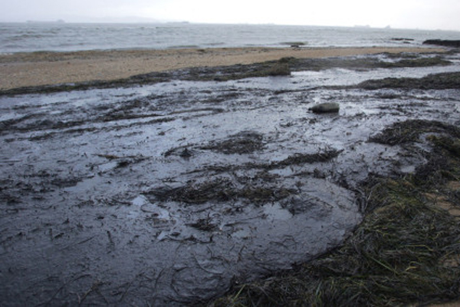
Regional problem
Problems and situations that affect the population of a country or part of the continent. To solve such problems need research.

Slide 6
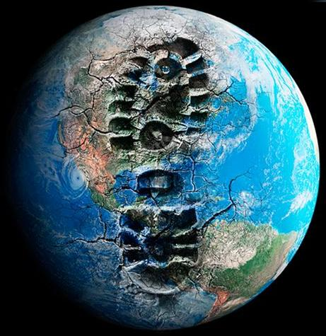
Global problem
The sharp warming
The ozone hole
Water pollutes man since ancient times
Erosion and deforestation
Desertification
If humanity is to continue on the current path of development, his death is believed leading ecologists of the world in 2-3 generations is inevitable.

