Slide 1
Theme:
Robotics- a part of our
future life.”
Presented by:
student of the 9th V form
Kopyak Danil

Slide 2
Actuality
In modern world the development of technology increases every day. We’ve already had a lot of different computers and robots which help us in different spheres of our life, starting with house assistant and finishing with space research.
So as a result it is important nowadays to investigate what impact can robots work on peoples’ life

Slide 3
Aims:
To investigate what types of robots are known for pupils of my age.
To find out what types of robots are popular now and where
To predict the future of robot technologies.

Slide 4
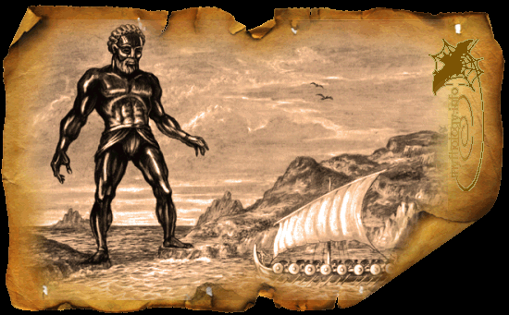
The history of robotics is very interesting and very long. It is closely connected
with the development of technology, science and the basic principle of progress. The
facts of the first robots can be found in Ancient Greece which name was Talos – “Sun”
by translation.
Talos was a bronze man, Talos' single vein was leading from his neck through his
body to one of his feet, which was closed by a bronze nail or a bronze pin

Slide 5
Since that time robotics starts developing and now we
can find a lot of robots which can change our life in the
future.

Slide 6
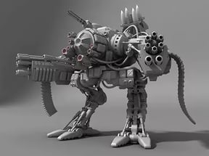
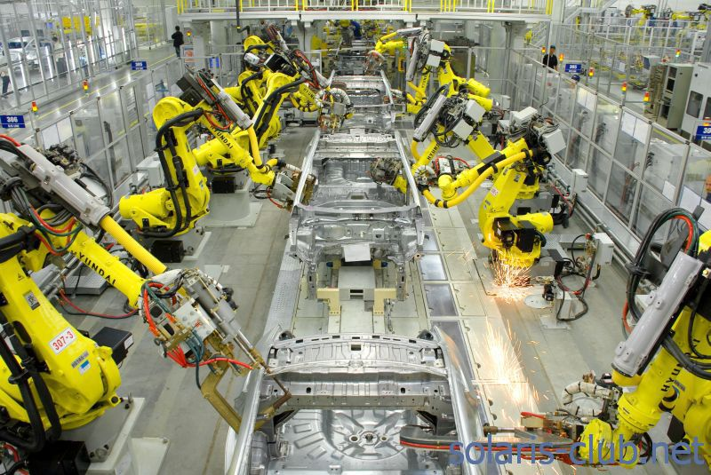
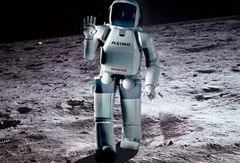
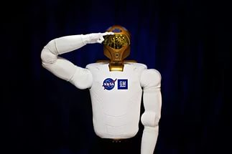
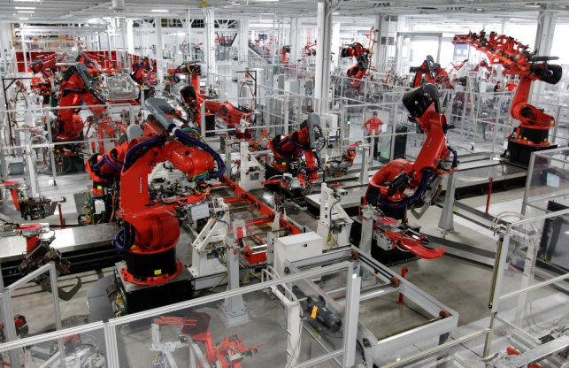
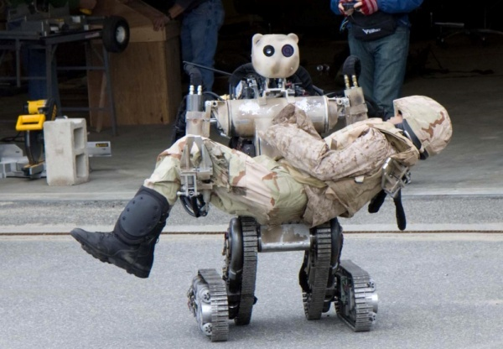
Types of robots
Space investigation
military
manufacturing

Slide 7
Quiz
What kind of robotics is popular now? (17)

Slide 8
Quiz
What countries is robotic industry developed?
Japan
The USA
Germany
Russia

Slide 9
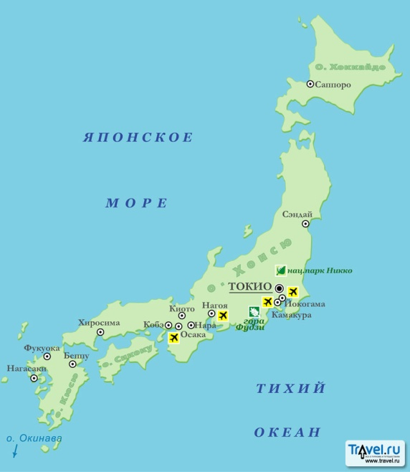
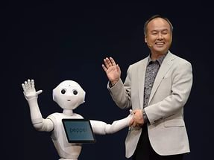
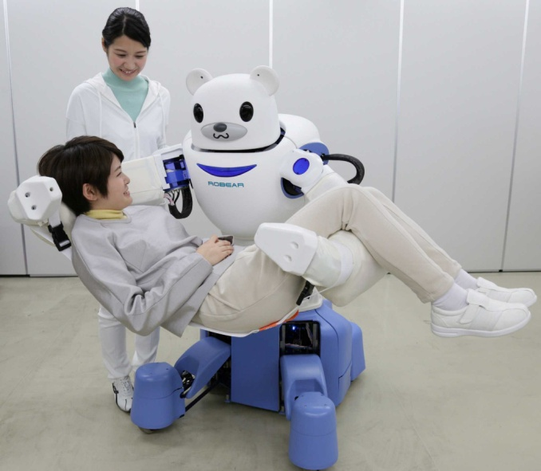
Why have pupils chosen these countries?
JaPAN
Small territory
Care for generation
Outstanding scientists

Slide 10
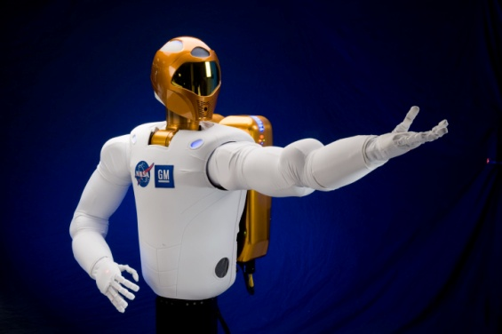
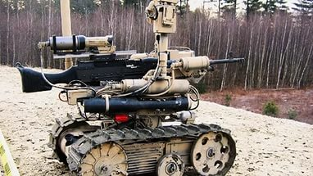
Why have pupils chosen these countries?
The USA

Slide 11

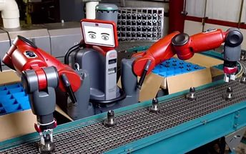
Why have pupils chosen these countries?
Germany

Slide 12
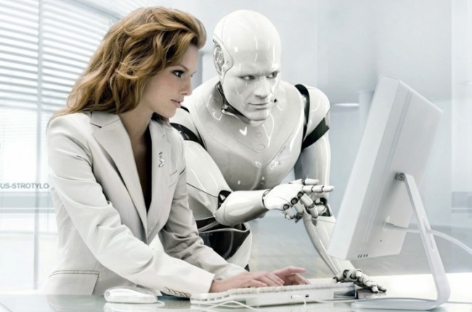
Why have pupils chosen these countries?
Russia

Slide 13
What spheres of industry will the robotics be more important in the future?

Slide 14

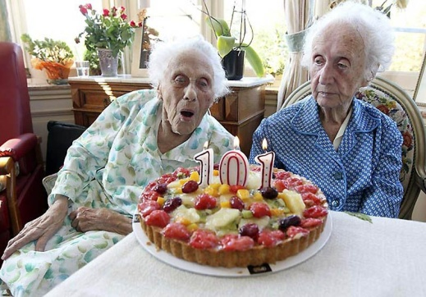

People can be ill
People want to live more
People don’t want to become old
People want to cure illnesses fast
Many people are afraid of doctors’ mistakes

Slide 15
Results
In my work I wanted to investigate what types of robots in the world are known for pupils. According to my research I’ve found out that a lot of pupils know much about robotics as a science and which of them are popular. During my research I could find where and what sphere of robotics would be developed in the future.

Slide 16
Bibliography
Искусственный интеллект. Современный подход 2-е изд. / Artifical Intelligence: A Modern Approach- Рассел С., Норвиг П.-2007
https://ru.wikipedia.org/wiki/
http://www.dailytechinfo.org/robots/
http://royallib.com/author/azimov_ayzek.html

