Slide 1
Expo 2000. Hannover.
Created by:
Vashutkina Anna
Vigandt Rudol’f
Bachuk Gleb
Porchelli Daniel’

Slide 2
History:
On June 14, 1990, the international world's fair organization B.I.E. awarded Expo 2000 to Hannover, beating out Toronto by a 21 to 20 vote. In 1992, the architects Studio Arnaboldi/Cavadini of Locarno won an international design competition for the masterplan of the exhibition grounds. On June 12 of that same year, a survey conducted by the city council was made public showing only 51.5% of area residents supported hosting the expo.

Slide 3
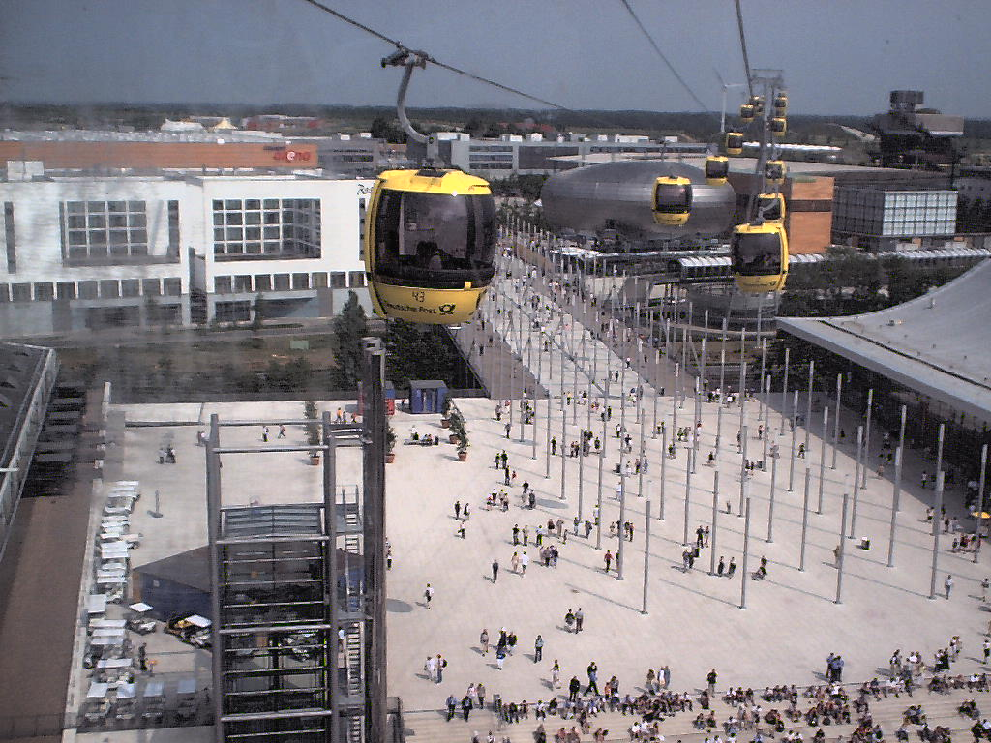
Construction:
In 1995, the supervisory board agreed on the concept for the thematics of the fair. Construction finally began on April 22, 1996.
Unlike previous expos, which focused on present advances in science and technology, EXPO 2000 focused more on developing and presenting solutions for the future

Slide 4
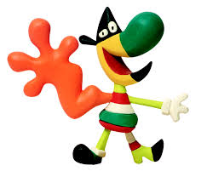
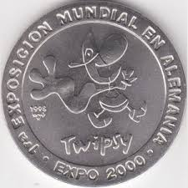
Official mascot:
Twipsy was the official Mascot of the EXPO 2000 . The character was created by the Spanish designer Javier Mariscal. His draft was selected in 1995 by an international jury out of 17 proposals in total. During the course of the Expo, Twipsy could be acquired on the EXPO area on forms of merchandise, ranging from a stuffed plush toy, to apparel such as on T-shirts, mugs, watches and other souvenirs, in addition to those with the EXPO logo.

Slide 5
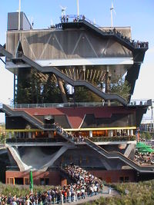
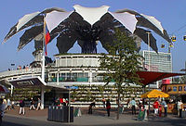
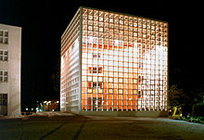
National pavilions:
Venezuela
Netherlands
Mexico

Slide 6
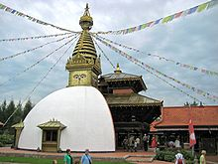
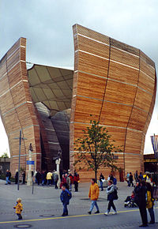
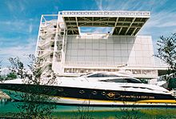
Nepal
Hungary
Monaco

Slide 7
Legacy:
Some of the buildings on the EXPO site were sold after EXPO 2000 ended, but most of the exhibition area is still used for major fairs in Germany, as it has been since 1949. The southeastern area around Expo Plaza has been turned into Hanover's new centre of information technology, design, media and arts.
Most of the national pavilion buildings were demolished following the fair. Some buildings (far more than in any other world expositions) were retained, including the Netherlands Pavilion. The structure has now fallen into disrepair.

