Slide 1
It is the emblem of Expo 1962

Slide 3
1962 World's Fair - One Dollar Token

Slide 7
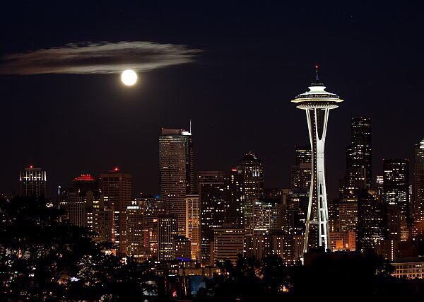
Space Needle. The most recognizable landmark of the city of Seattle

Slide 8
Food Circus

