Slide 1

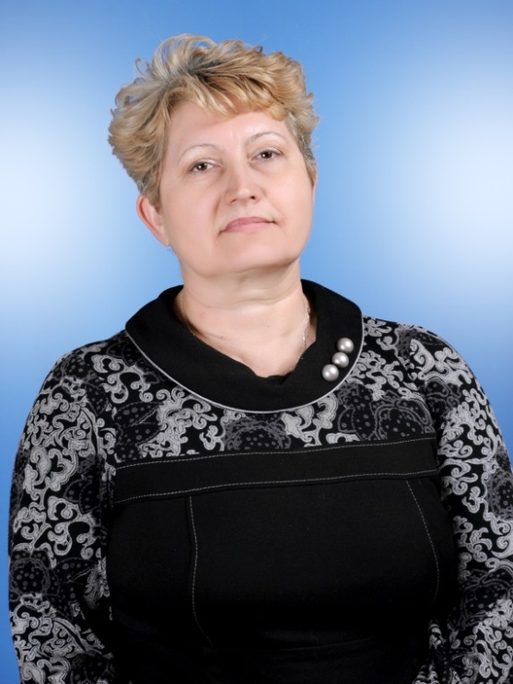
On – line lesson
in class 8 School 62
“ A Famous English Writer”
an English teacher
Shumay L.V

Slide 2
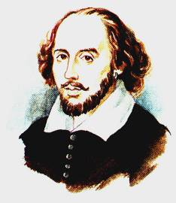
William Shakespeare

Slide 3
William Shakespeare

Slide 4
What are your impressions and feelings after listening to this song ? Complete the sentences:
I enjoyed the song | because | the singer sang at her best
I am delighted with the song |  | it arouses the feeling of admiration, love and sympathy
 |  | it arouses a great interest and a feeling of spiritual enrichment
I am thrilled with the song

Slide 5
Look at the plan of our lesson :
1.Pre - reading tasks: a)matching the new words with their translation will do school 65;b) our school 62 continues our lesson with phonetic drill of the names of Shakespeare’s plays.
2.School 62 reads the text about Shakespeare’s life and does three – level tasks on the text. Level 3
read the text and ask the questions on the missing information in their text. Level 2 – read the text and ask the questions on it . Level 1 make a conclusion on the text. During the lesson all the students will do the tasks on the text in pairs and groups.

Slide 6
3.Reflection of the lesson: a) School 66 joins us to complete the cluster on the text a) School 65 joins us to answer the questions of the quiz about W. Shakespeare ;
4. Evaluation criteria of students’ marks:
a)pronunciation ; b) the expressiveness ; c)lexical richness ;d)the number of replays.
5.H/w 6.Conclusion of the lesson. The teachers’ feedback of the lesson. What tasks are useful for you. What tasks have some disadvantages ? What are they ?

Slide 7
Answer these questions :
When and where was William Shakespeare born?
Did he have a good education?
Did he have a family?
What did he do in London?
When did he die?
Which of his famous plays do you know?

Slide 8
Match the new words with their translation.

Slide 9
New words | Translation
1.was born | a)был похоронен
2. respectable | b)умер
3.married | c)близнецы
4.twins | e)глобус
5.act | f)уважаемый
6.acting company | g)исполнялись
7.were performed | h)церковь
8.globe | i)играть на сцене
9.died | j)актёрская труппа
10.was buried | k)родился
11.church | l)женился

Slide 10
Phonetic drill of the names
of Shakespeare’s plays and some
other words from the text.

Slide 11
April 23; 1564; 1613 ;1587;
1616,William Shakespeare;
Stratford-on-Avon;
Anne Hathaway;
; the Globe Theatre ;
the River Thames; 37; 154.

Slide 12
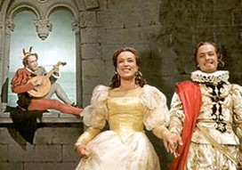
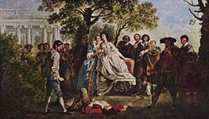
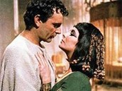
Phonetic drill :
Twelfth Night
As You Like It
Julius Caesar

Slide 13
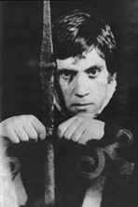
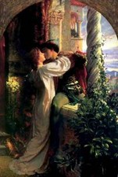
Hamlet
Romeo and Juliet

Slide 14
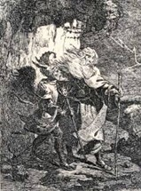
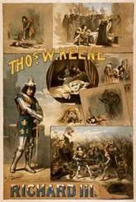
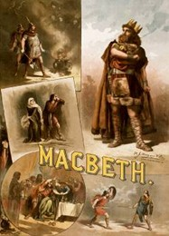
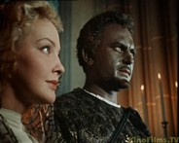
Richard III
Macbeth.
King Lear
Othello

Slide 15
Pay attention to Grammar!
Past Simple Active
Subject +V+ ed (V2) – Affirmative
Did + Subject + V ?- Questions
Subject + didn’t + V - Negative

Slide 16
Present Simple Passive
Subject + am, is, are + V ed (V3)-Affirmative
Am, is, are + Subject Ved (V3 )- Questions
Subject + am, is, are + not + Ved (V3 )- Negative
Past Simple Passive
Subject + was(were ) + V ed (V3)- Affirmative
Was(Were) +Subject + Ved (V3 )- Questions
Subject + am, is, are + not + Ved (V3 )- Negative

Slide 17
Fill in the missing words and compose the dialogue about William Shakespeare :
What --- you ---- about his family ?
How many children ---- he ----- ?
When --- he -- ?
What --- you --- about the further life of his plays and poems?
When --- William Shakespeare born ?.
--- William ---- to school ?
Who--- he marry , when William --- 18 ?
When --- William ---- to work in London?
What --- he ---- in London?

Slide 18
Let’s go on our excursion !

Slide 19
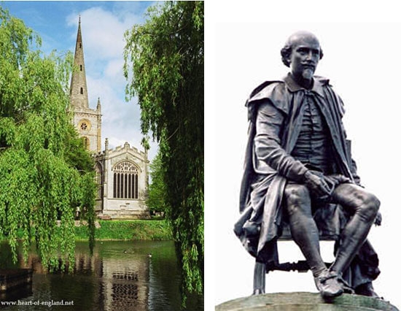
The bronze statue of Shakespeare. There are small figures of Shakespeare’s famous characters.

Slide 20

His father John
Shakespeare was a
…. and his mother Mary Arden was from a … family.
Coat of Arms
with the motto

Slide 21
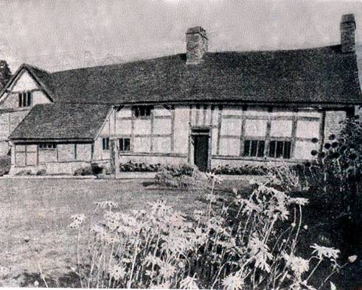
This is a typical farm house of the period. Here lived Shakespeare’s mother.

Slide 22
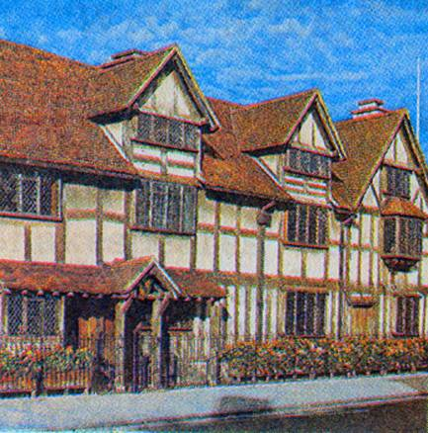
Shakespeare’s birthplace
in Henley Street.

Slide 23
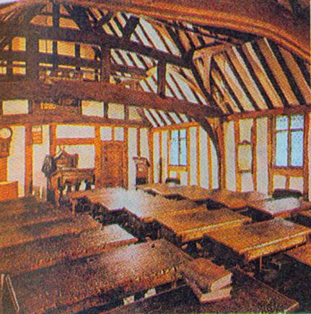
This is the classroom at school where
Shakespeare….

Slide 24
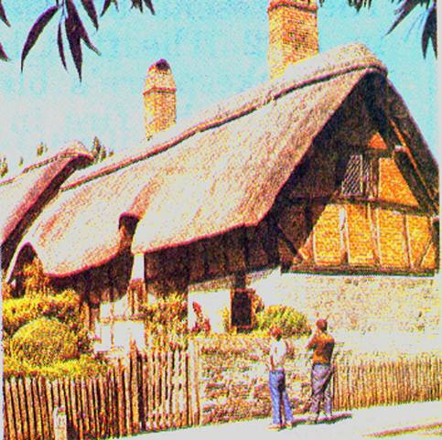
Anne Hathaway’s
cottage where she
was born in 1556.

Slide 25
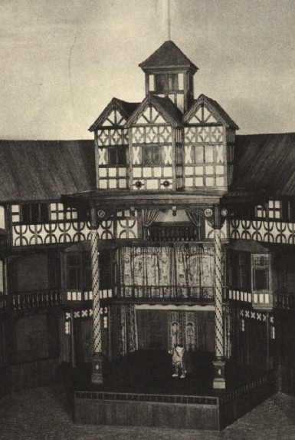
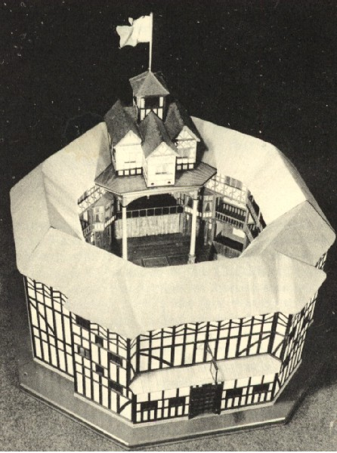
The Globe Theatre
Top view of
Shakespeare's
Globe Theatre
Entrance of The Globe Theatre

Slide 26
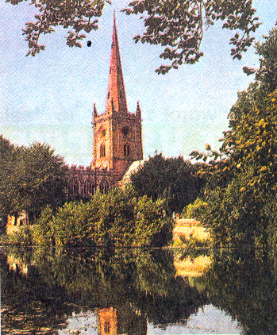
This is the Holy Trinity Church

Slide 27
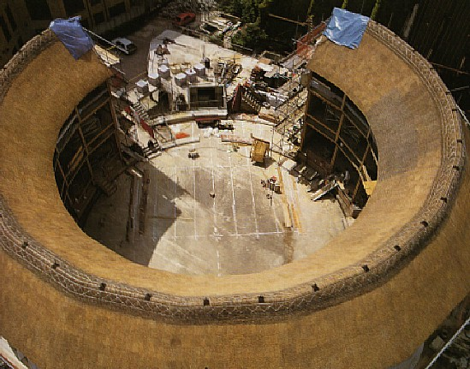
New Globe Theatre
Rebuilt Globe Theatre on the Thames river . Built on September 19, 1999.

Slide 28
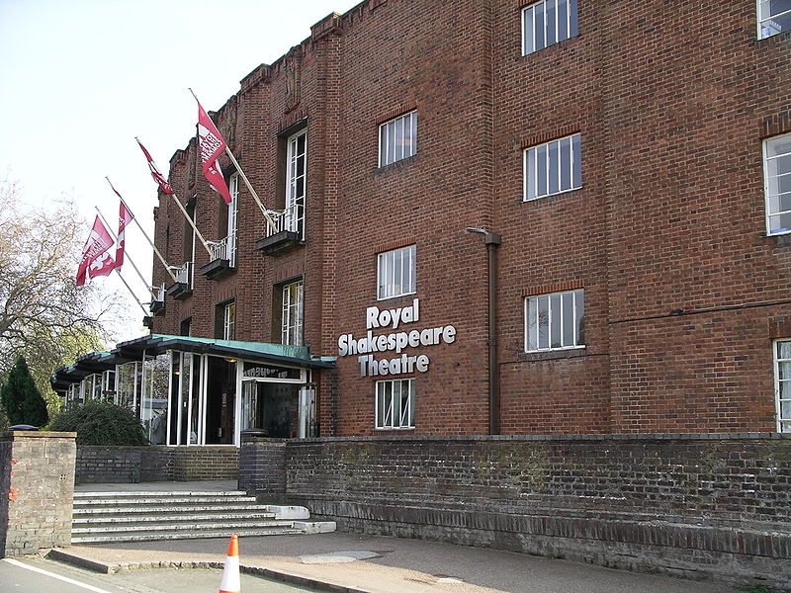
Royal Shakespeare
Theatre

Slide 29

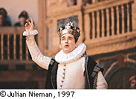
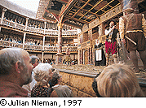
Shakespeare’s plays are…

Slide 30
a) On April 23, 1564 William Shakespeare was … | b) His father was …
c) During some years his three children were … | g) When he was 18 , William Shakespeare married …
h)In 1587 Shakespeare went … | d)…born: Susannah, the eldest, then twins -a son, Hamnet, and another girl, Judith.
k)…Anne Hathaway, a rich farmer's daughter some years older than himself. | j)…to London on foot without much money in his pocket , he wanted to become an actor.
i) In London Shakespeare began…. | f)…born in Stratford-on-Avon
p) In 1613 he stopped writing and …. | o) … to act and write plays and sonnets
e)…a respectable glove-maker l)…plays and 154 sonnets. | n) He wrote 37… m)…went to live in Stratford where he died on April 23 ,1616.

Slide 31
Make a cluster on the text
about
William Shakespeare

Slide 32
William Shakespeare

Slide 33
Do the quiz on the theme
“William Shakespeare”.

Slide 34
1.When and where was Shakespeare born?
2. What do you know about his
parents ?
3. Did William Shakespeare go
to school?
4.Who was Anne Hathaway for William Shakespeare ?

Slide 35
5.What do you know about
the role of the Globe theatre in
Shakespeare’s life?
6.When and where did Shakespeare die?
7.Do you know the titles of his most famous plays?

Slide 36
H/W. Level 3 - to write an essay « My favorite writer». Level 2- to write an essay»My favorite writer» on key words: great, was born ,his/her parents, went to school, married, children, began to write, wrote, his novels/stories/poems are read, in the whole world. Level 1- to put the words in the correct order to make the sentences about Shakespeare:
1)was ,On April 23, 1564, William Shakespeare ,born.
2)were , rich, His ,parents ,people.
3)He ,married, got , had ,and , three ,children.
4)37, wrote, He, 154, sonnets.
5)In 1613 writing he, stopped, 1616 ,and ,died.
6) sonnets, plays ,His, performed ,and ,are, in the whole,
world

Slide 37
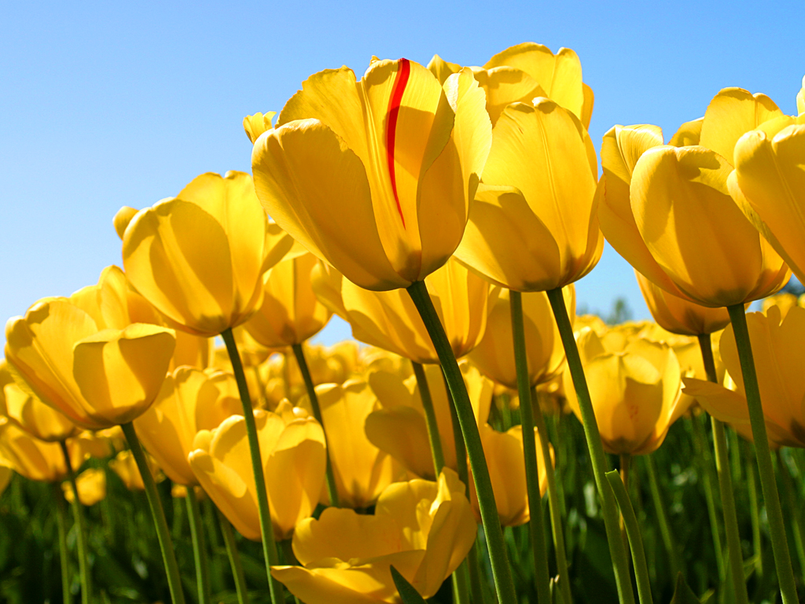
Thank you for
attention!

