Slide 1
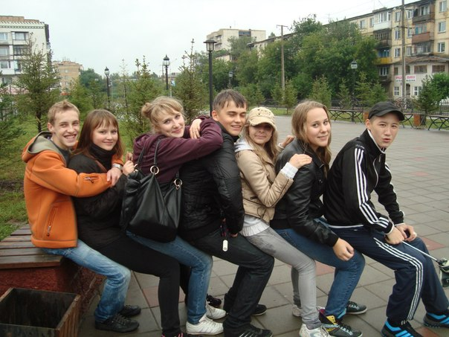
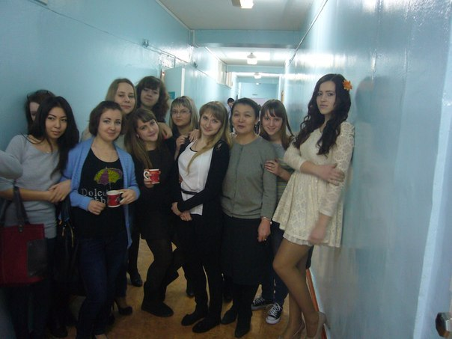
The friend is the man who knows all about you, and still likes you. Elbert Hubbard
By Eugeniya Makhina

Slide 2
Active Vocabulary
precise definition-точное определение
kinship [ˈkɪnʃɪp] родство
Joseph Addison (1 May 1672 – 17 June 1719) was an English essayist, poet, playwright and politician
Samuel Butler (4 or 5 December 1835 – 18 June 1902) was an iconoclastic Victorian-era English author who published a variety of works
Plutarch c. 46 – 120 AD,was a Greek historian, biographer, and essayist, known primarily for his Parallel Lives and Moralia
Clive Staples Lewis (29 November 1898 – 22 November 1963), commonly called C. S. Lewis and known to his friends and family as "Jack", was a novelist, poet, academic,literary critic

Slide 3
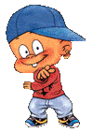
Best Friends means different things to different people. Some insist that you can have only one best friend. Others assert that they have best friends for different aspects of their personalities. Whatever the precise definition, your best friend is the person who gets you. They understand who you are and what you are saying. The greatest distance cannot separate best friends. You will always feel a kinship with them, and be able to instantly continue the friendship even after not talking for many years.

Slide 4
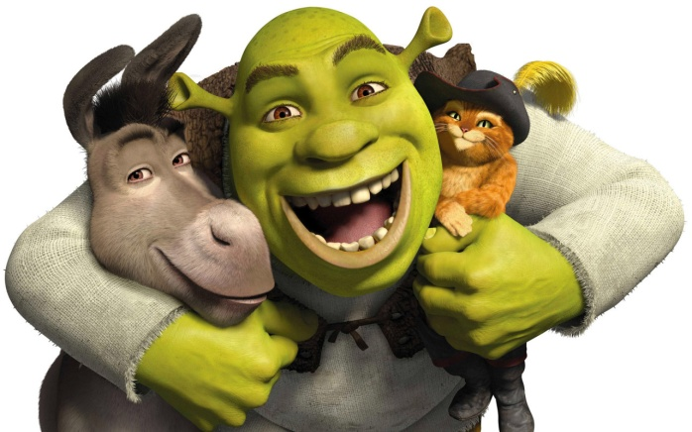
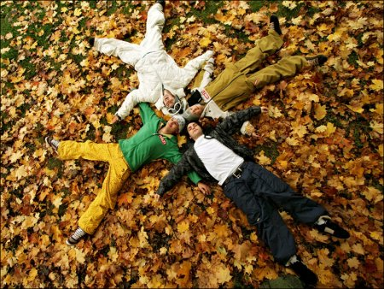
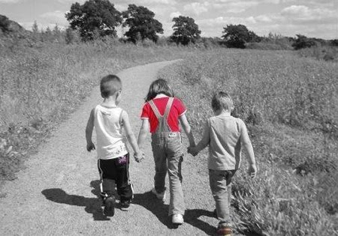
F
R
I
E
N
D
Fight for you
Respect you
Include you
Encourage you
Need you
Deserve you

Slide 5
Aphorisms about friendship
Talking with a friend is nothing else but thinking aloud.
Joseph Addison
Friendship is like money, easier made than kept.
Samuel Butler
I don`t need a friend who changes when I change and who nods when I nod; my shadow does that much better.
Plutarch
Friendship is born at that moment when one person says to another: ‘What! You too? I thought I was the only one.’
C.S. Lewis

Slide 6
How to Be a Great Best Friend?

Slide 7
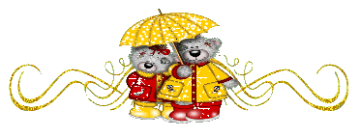
There are 5 ways:
Respecting Yourself
Building Trusting and Loyalty
Spending Time Together
Caring For Each Other
Being Realistic with Each Other

Slide 8
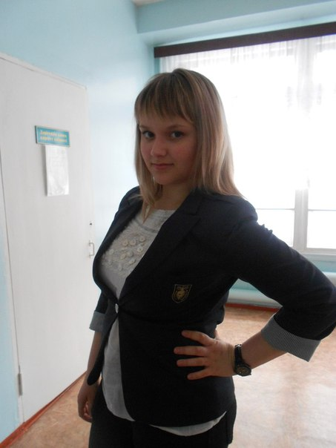
And now I want to tell you about my best friend
Sasha
Shishlova

Slide 9
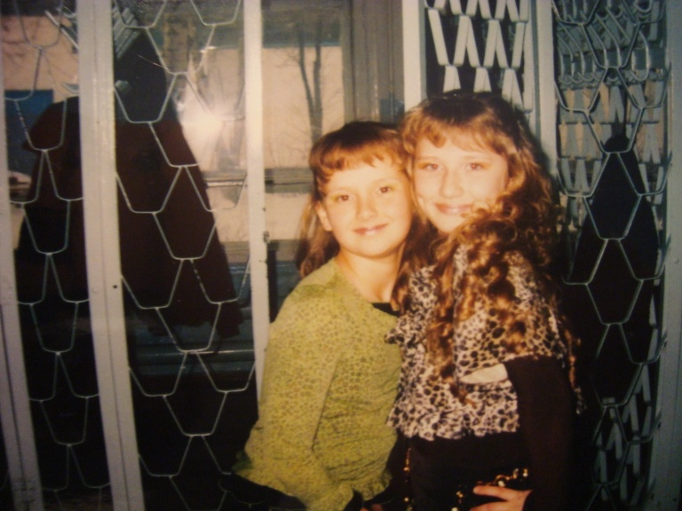
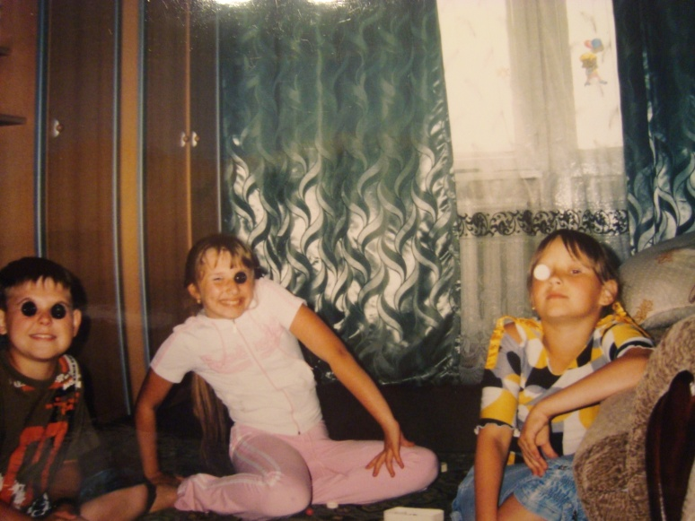
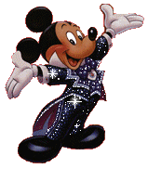
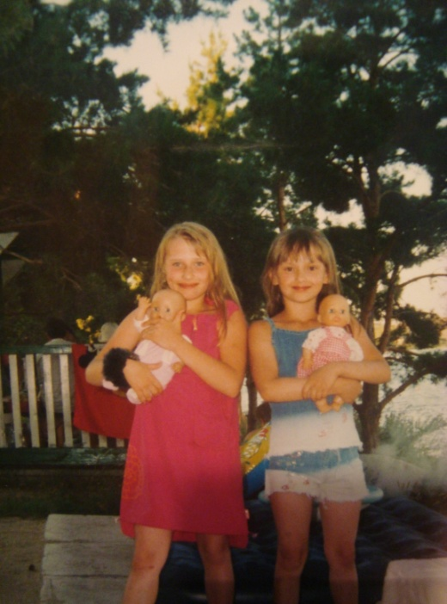
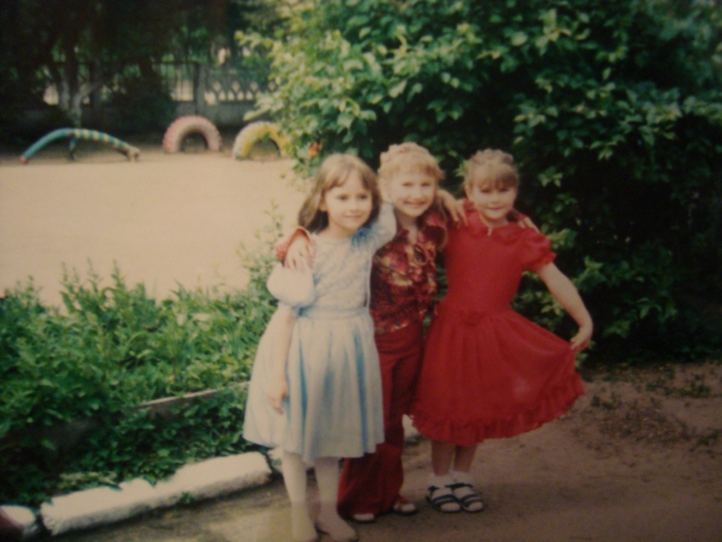
We’ve known each other for 13 years

Slide 10
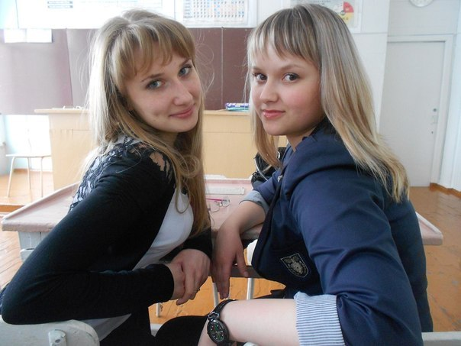
Sasha is 17 years old. She is not tall, has dark hair and brown eyes. Sasha is very friendly, loyal, reliable and had good sense of humor. She can drop everything and come to rescue me if I am in a trouble. We have very much in common and like spending time together.

Slide 11
She likes
To help animals
To watch interesting programs and films
To narrate different stories
To communicate with people
To study languages

Slide 12
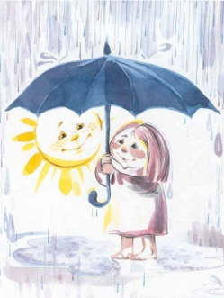
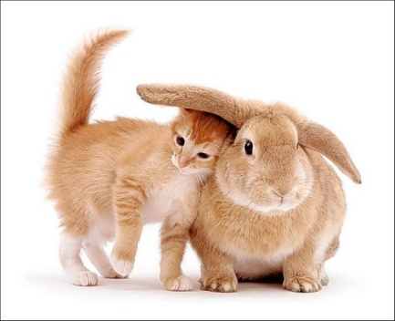
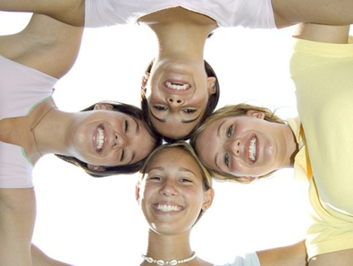
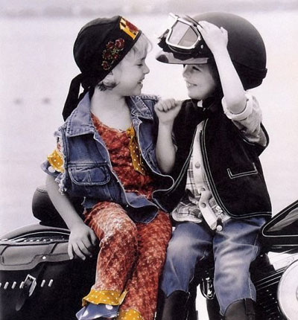
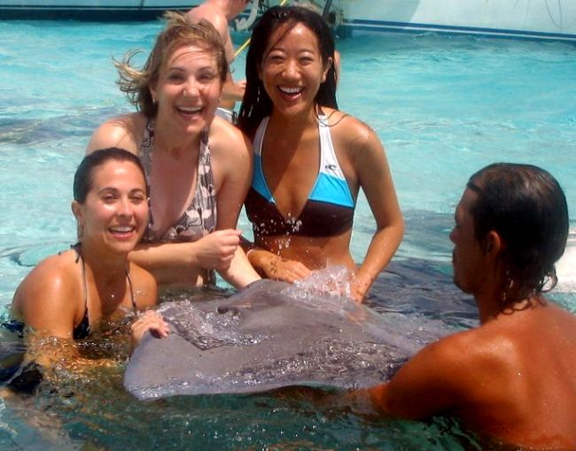
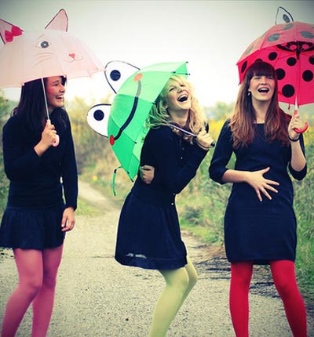
When you're down in troubles,
And you need a help and care,
And nothing, oh nothing is going right
Close your eyes and think of me…
And soon I will be there,
To brighten up even your darkest nights

