Slide 1
Phonetic drills
Rub your eyes and look around,
Litter lying on the ground,
Bottles, cans and polythene-
Take the tip and change to green!
Animals and plants have died,
People starve to feed our pride,
For the life that might have been
Take a stand and change to green!
There’s so much that isn’t right,
It could get you well uptight,
So make a start and change the scene

Slide 2
24.01.2012 Seminar for teachers of Karaganda city: the theme
” Effective foreign methodic for teaching English language”
Lesson for the 6 th form school 10 : The theme “ How green are you”

Slide 3
Objective: Students will understand the following:
1.The threat to ecology is a complex problem
2.The condition of the environment and what we can do to help and improve it.

Slide 4
The students will
Demonstrate their educational knowledge of the environment
Understand why it is important to keep the environment free of pollution
Learners will be ready make some progress in English speaking and writing
They create own view to the problem of ecology
Increase their confidence throw independence activities of children
Provides regular opportunities for revision and self-assessment

Slide 5

How green are you!

Slide 6
The Environment
Warm- up
1.Let’s play the game “Bingo”
animal | building | Natural feature
Lion Dog Elephant Horse Snake | Theatre Cottage Concert hall House Bridge | Mountain Hill Wood Lake Forest Sea

Slide 7
Grammar time
..
.
?
Noun
Pronoun
SHOULD Can
(modal verb)
VERB
SHOULD NOT
(shouldn’t)
Can’t
VERB
Noun
Pronoun
SHOULD
NOUN
Verb
can

Slide 8
Grammar Time
(look at the blackboard)
work in pairs
Students get some cards
We should…………………
We shouldn’t………………

Slide 9
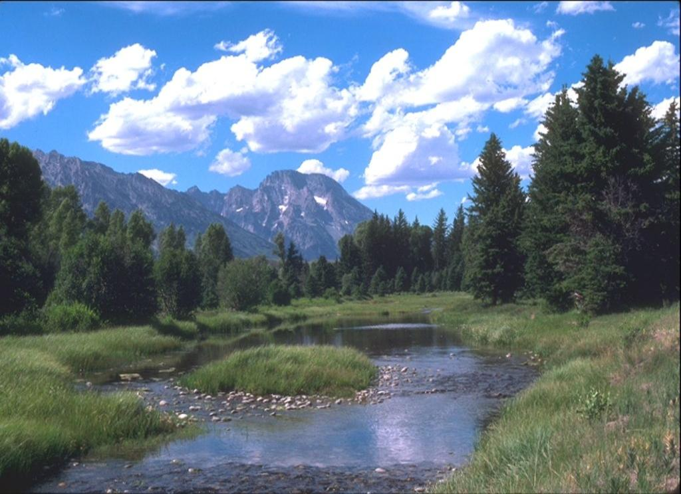

Slide 10
Overview:
Look at the apple. Imagine it`s our Earth. I`m cutting it into 4 pieces. Three quarters of the Earth surface is water and only 1/4 is land. One half of it is habitable. The Earth is our home. We want our home to be clean and new. We want to see blue seas, green trees, and clear sky. If you care about your planet, don’t make it dirty. Don’t leave plastic bags, bottles, newspapers in the streets, parks, forests. Pick up the litter if you see it. Remember that the future is in our hands.

Slide 11
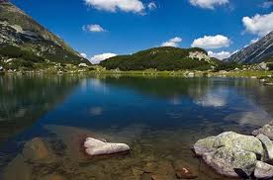
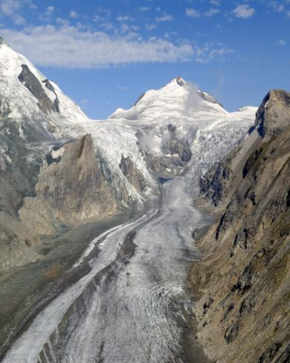
3.Read the text with new words and match their meaning:
RONDELLE

Slide 12
5.Word building
A fine n.- айыппұл view n.- көрініс,түр
Fine adj.-әсем throw v.-лақтыру
ill v.- ауру, наусқас litterbin n.- қоқсық
Illness-ауру салатын ыдыс
Punish v.- жазалау litterbug n.- қоқсық
Punishment n.-жаза тастаушы
Litter n.- қоқсық
Spoil v.- бұзу,бүлдіру

Slide 13
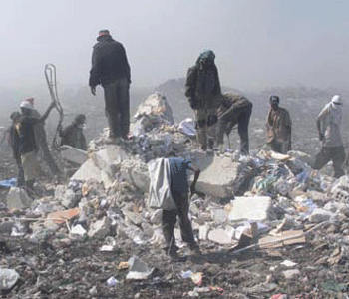
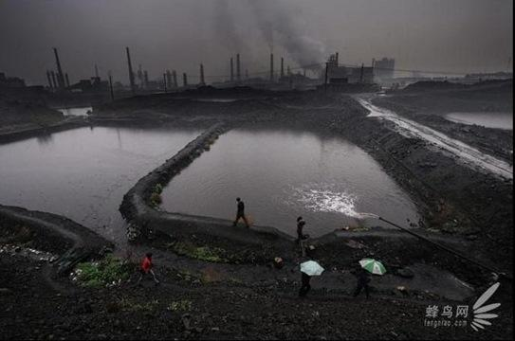
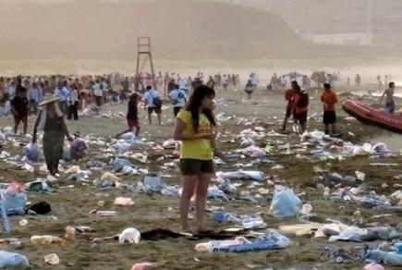
2.Pre-reading task: trash, litter,garbage,rubbish- мусор

Slide 14
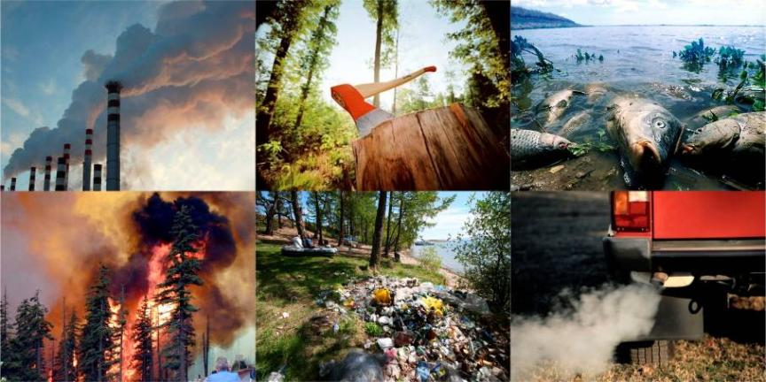
ENVIRONMETAL PROBLEMS

Slide 16
4.Text: Litter is a problem
Litter is a food, paper and cans on the ground. People don’t always put their litter in the litter bin. Litter makes the place look dirty and spoils the view of the city.
Litter is a health problem. It brings illnesses. Some people want to control litter. They never throw litter themselves.
In most cities the law punish people who throw litter on the streets. They usually pay a fine. Don’t be a litterbug.

Slide 17
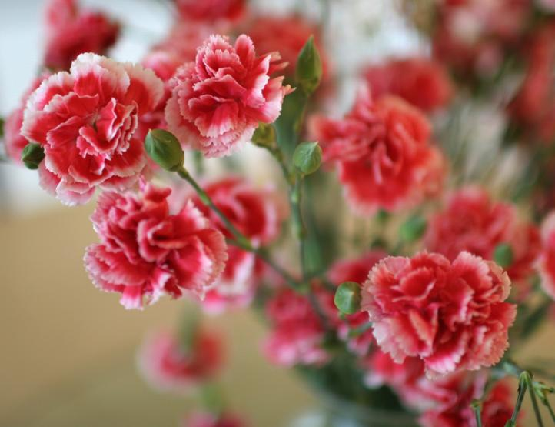
Reflection

Slide 19
Read together!
1.We should stop polluting the air.
2.We can die.
3. We should stop dumping waste.
4 We can die.
5. We should protect our environment.
6. And take care of the animals or
7. We can die.
8.But why can’t people understand it?

Slide 20
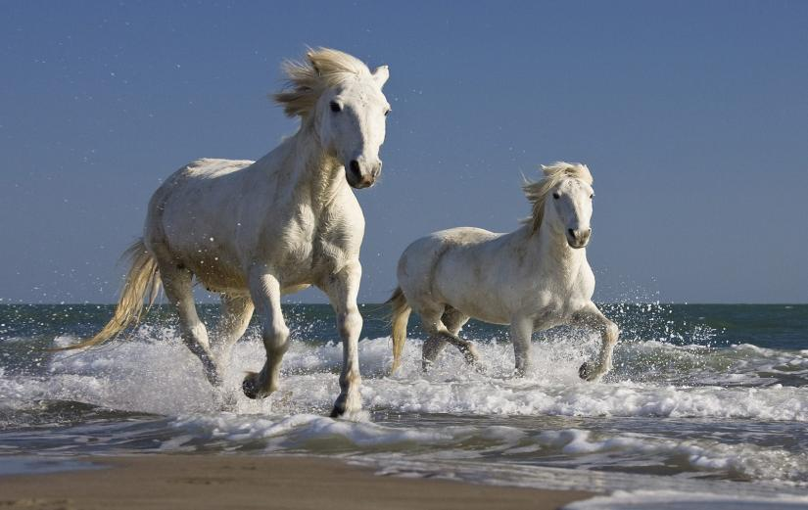
Save and help………
Nature, animals, people, children

Slide 21
RONDELLE
Rub your eyes and look around,
Litter lying on the ground,
Bottles, cans and polythene-
Take the tip and change to green!
Animals and plants have died,
People starve to feed our pride,
For the life that might have been
Take a stand and change to green!

Slide 22
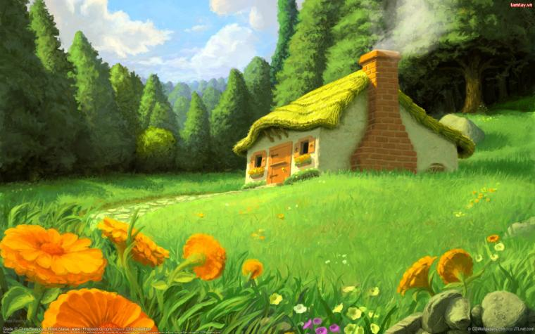

Slide 23
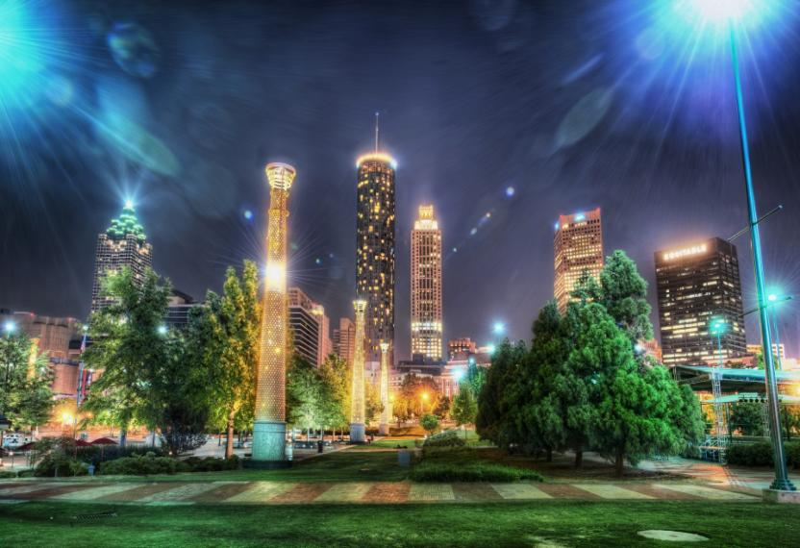
Cities

Slide 24
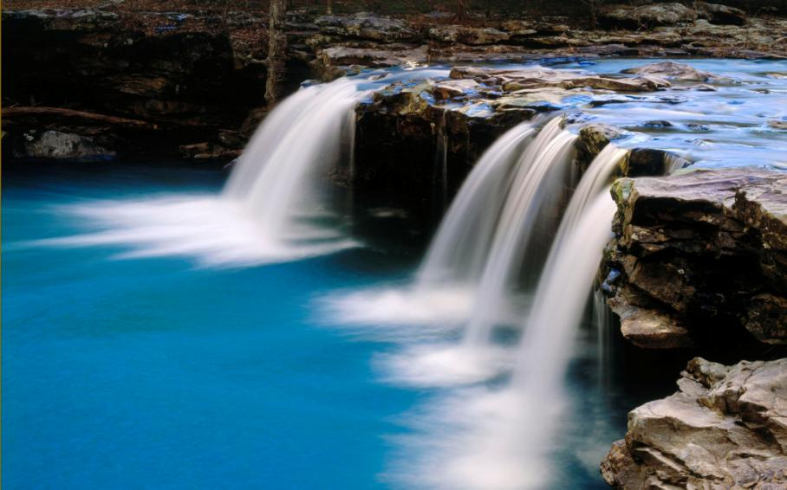
Water

Slide 25
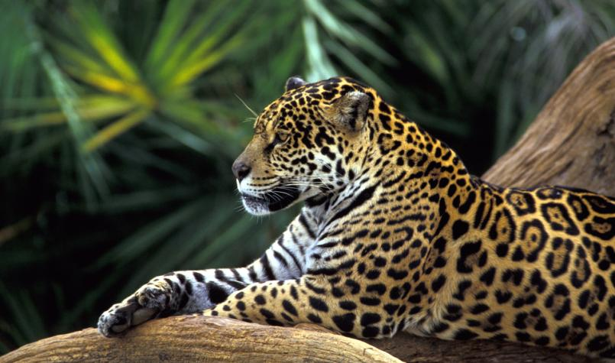
animals

Slide 26
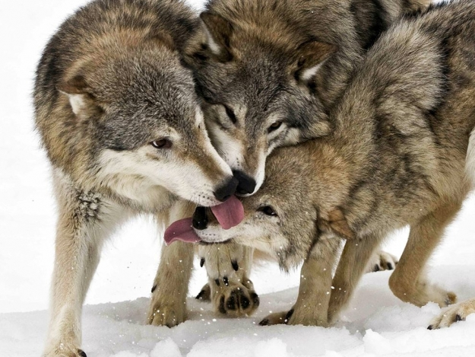

Slide 27

WE SHOULD DO IT

Slide 28
International organizations

