Slide 1
КГУ СОШ № 10 «Поговорим об Америке» внеклассное открытое мероприятие 8 классе 2012-2013 учебный год
Учитель английского языка
Есимканова Алтын Даулетовна

Slide 2
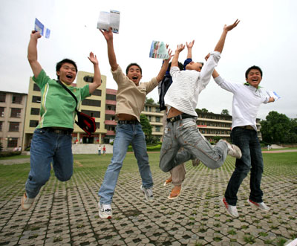
Speaking about USA

Slide 3
O beautiful for spacious skies...

Slide 4
for amber waves of grain...

Slide 5
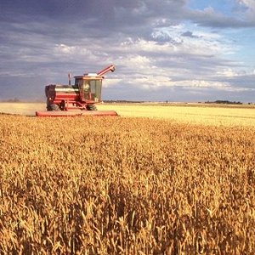
For purple mountain majesties, above the fruited plain...

Slide 6
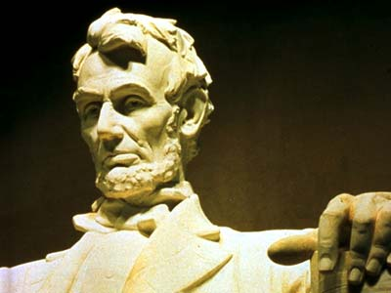
America, America, God shed his grace on thee...

Slide 7
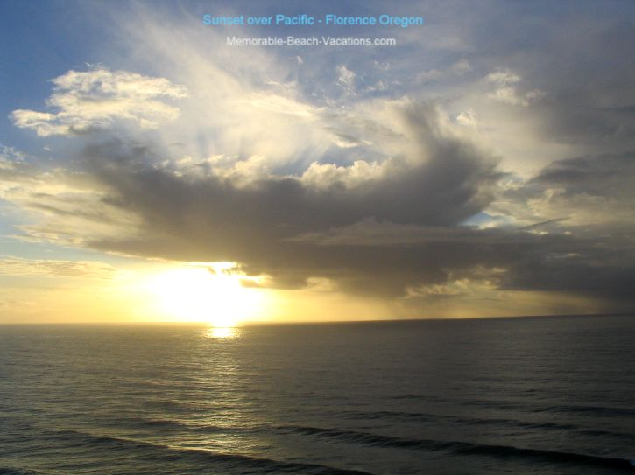
...and crown thy good with brotherhood from sea to shining sea.

Slide 8
O beautiful for patriot dream that sees beyond the years...

Slide 9
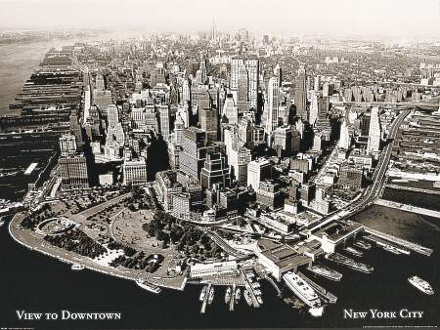
Thine alabaster cities gleam undimmed by human tears...

Slide 10
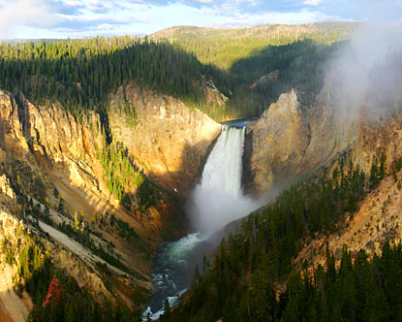
America, America, God shed his grace on thee...

Slide 11
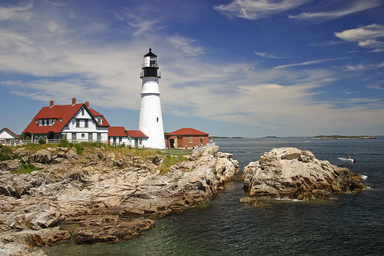
And crown thy good, with brotherhood from sea...

Slide 12
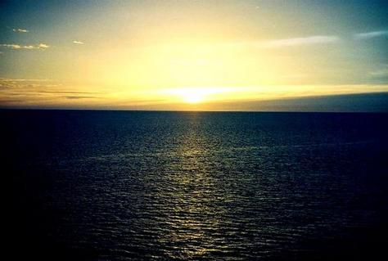
To shining sea!

Slide 13
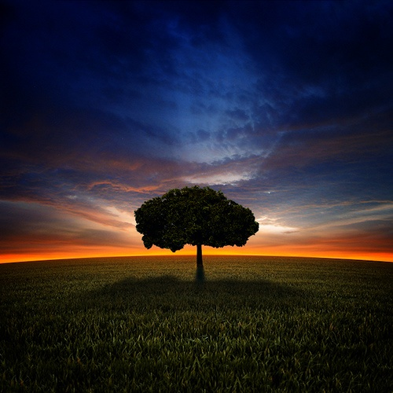
Goodbye Song
So long (echo)
Goodbye (echo)
See ya soon (echo)
My friend (echo)
So long (echo)
Goodbye (echo)
See ya soon (echo)
My friend (echo)
So long (echo)
Goodbye (echo)
Till we meet (echo)
Again (echo)
So long (echo)
Till later (echo)
So long (echo)

