Slide 1
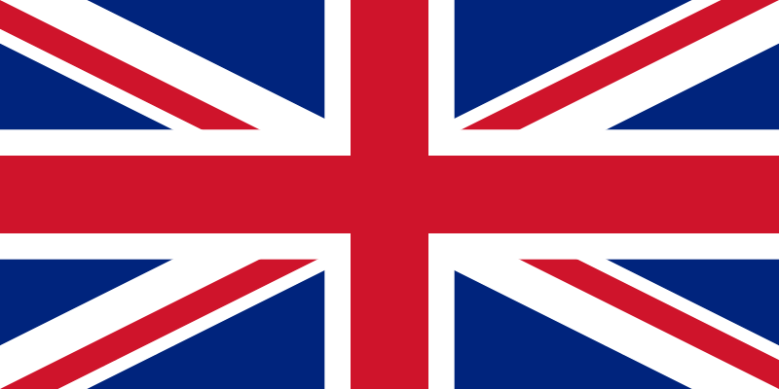
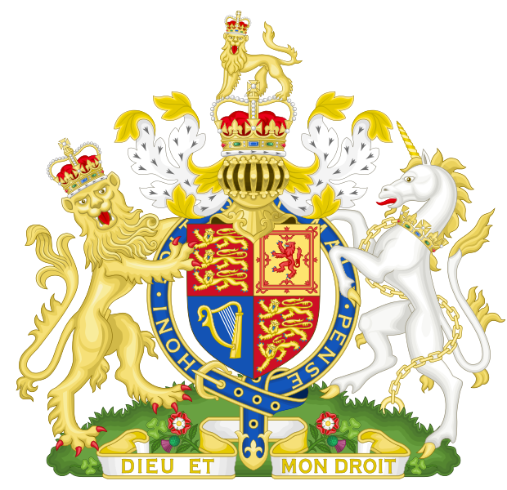
The United Kingdom

Slide 2
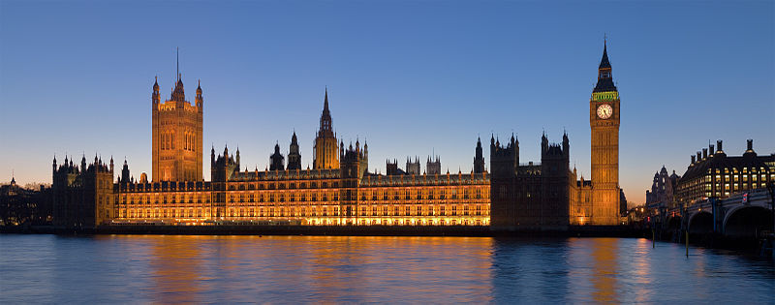
The United Kingdom of Great Britain and Northern Ireland, commonly known as the United Kingdom (UK) and Britain, is a sovereign state located off the north-western coast of continental Europe.

Slide 3
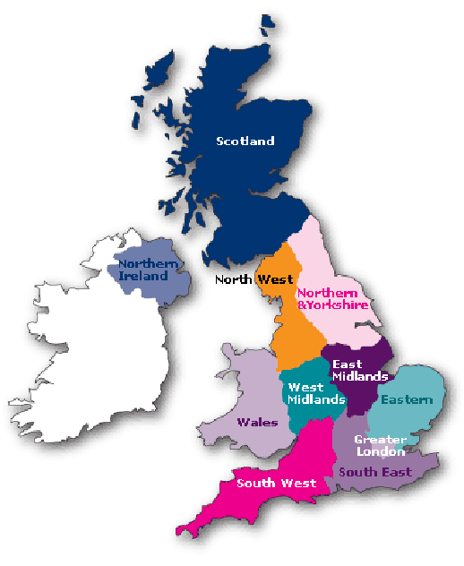
The country includes the island of Great Britain, the north-eastern part of the island of Ireland and many smaller islands.

Slide 4
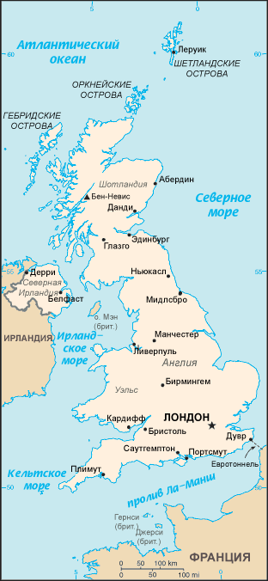
Northern Ireland is the only part of the UK that shares a land border with another state—the Republic of Ireland. Apart from this land border, the UK is surrounded by the Atlantic Ocean in the west and north, the North Sea in the east, the English Channel in the south and the Irish Sea in the west.

Slide 5
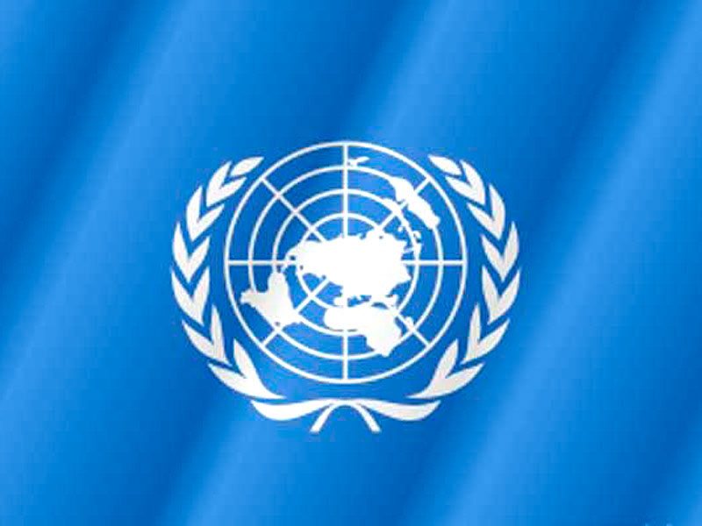
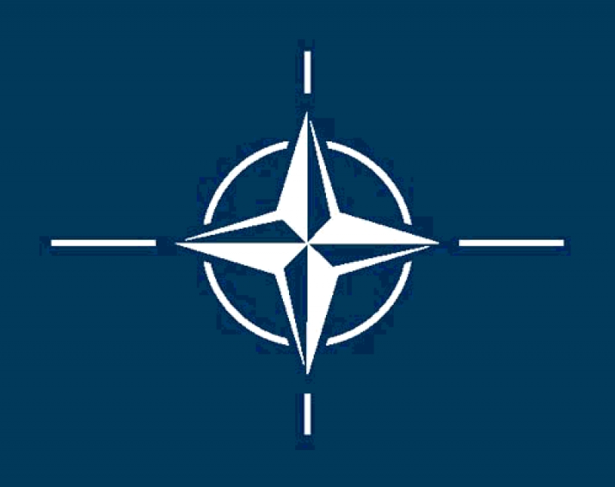
The UK has been a permanent member of the United Nations Security Council since its first session in 1946. It has been a member of the European Union. It is also a member of the Commonwealth of Nations, the Council of Europe, the G7, the G8, the G20, NATO, the Organisation for Economic Co-operation and Development (OECD) and the World Trade Organization.

Slide 6
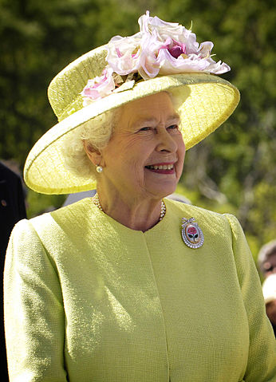
The United Kingdom is a unitary state under a constitutional monarchy. Queen Elizabeth II is the head of state of the UK as well as of fifteen other independent Commonwealth countries. The monarch has "the right to be consulted, the right to encourage, and the right to warn"

Slide 7
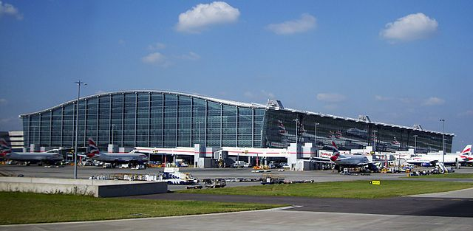
A radial road network totals 29,145 miles (46,904 km) of main roads, 2,173 miles (3,497 km) of motorways and 213,750 miles (344,000 km) of paved roads. In 2009 there were a total of 34 million licensed vehicles in Great Britain.

Slide 8
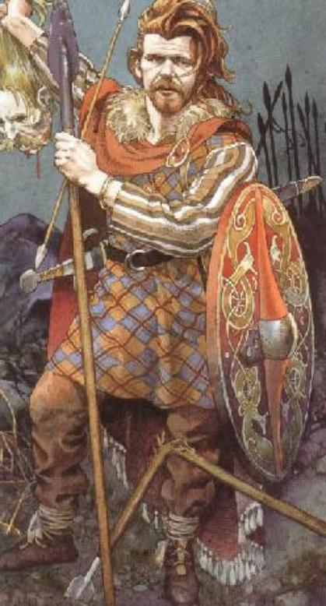
Historically, indigenous British people were thought to be descended from the various ethnic groups that settled there before the 11th century: the Celts, Romans, Anglo-Saxons, Norse and the Normans.

Slide 9
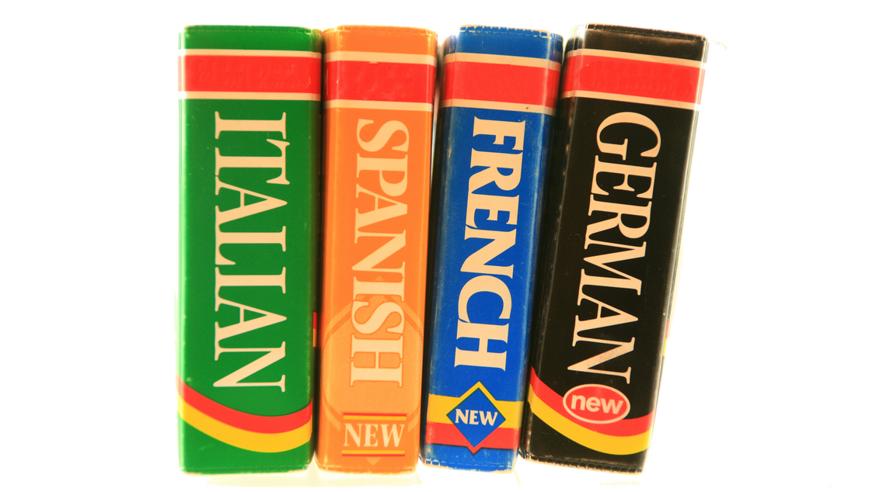
The UK's de facto official language is English. It is estimated that 95% of the UK's population are monolingual English speakers. 5.5% of the population are estimated to speak languages brought to the UK as a result of relatively recent immigration.

Slide 10
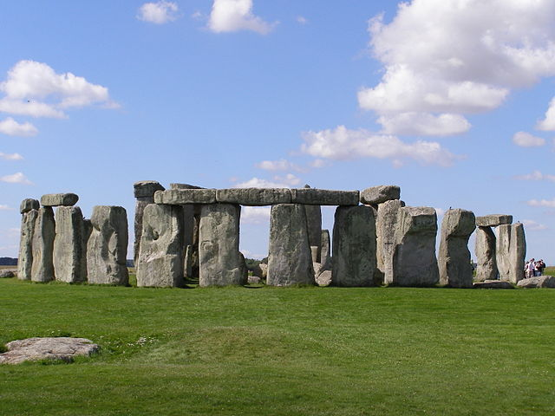
The End

